Slide 1
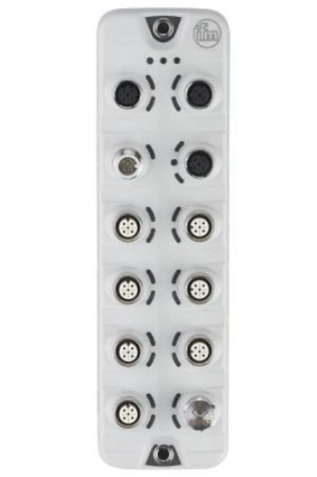
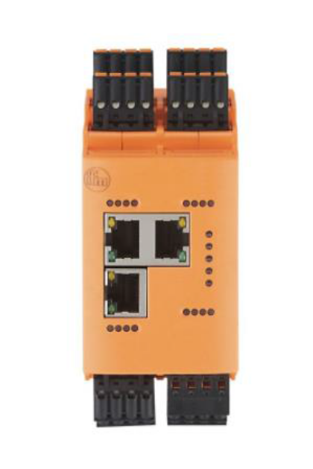
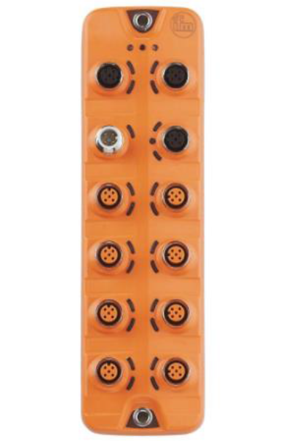
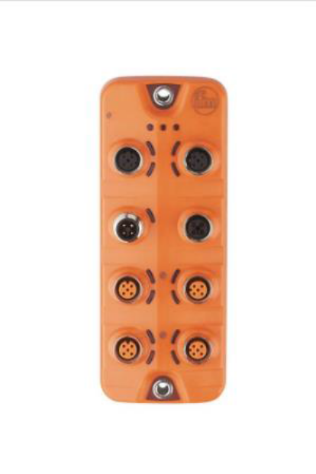
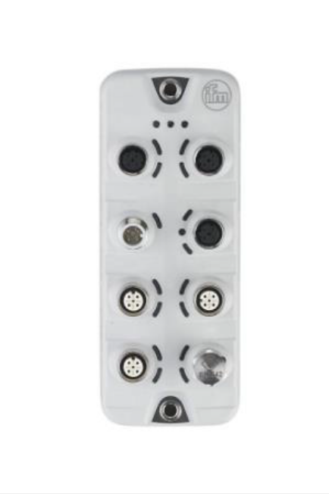
AL13xx AL19xx Setting IP Address
Configuring the AL13xx AL19xx IO-Link Master
Set IP- address

Slide 2
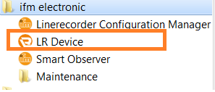

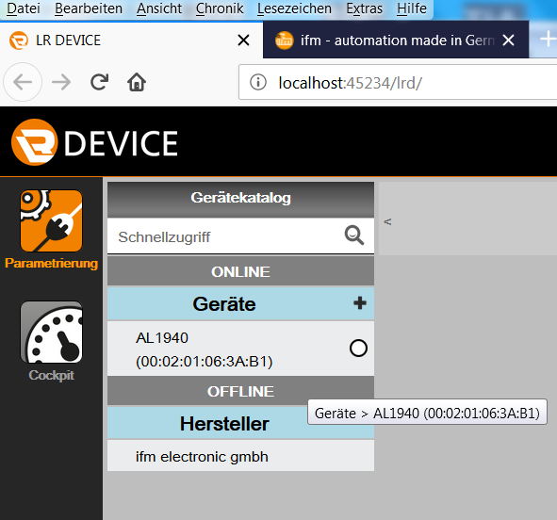
AL13xx AL19xx Setting IP Address
Open LR Device software
Scan Device
Check if IoT- port is connected !

Slide 3
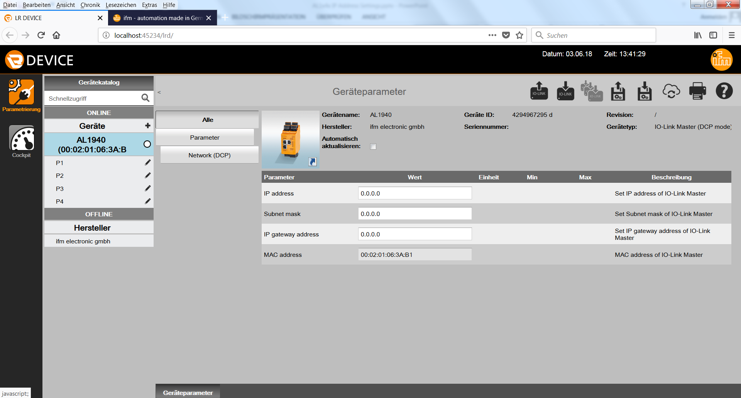
AL13xx AL19xx Setting IP Address
3. Read Device Parameter

Slide 4
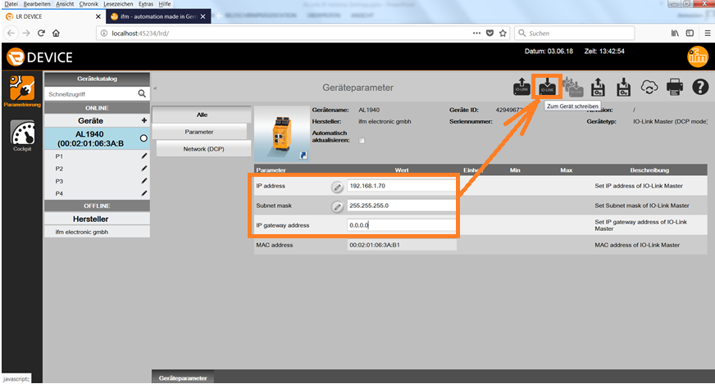
AL13xx AL19xx Setting IP Address
4. Change IP- Address of IoT- port and write to device

